Slide 1
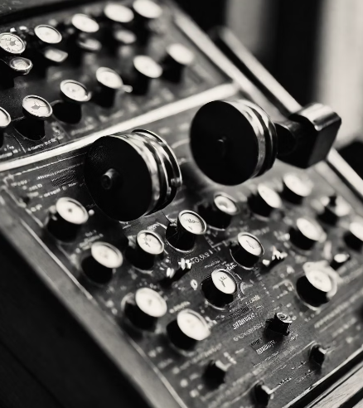
Morse Code: The Language of Dots and Dashes

Slide 2

Members
-Tejas araganji
-Krishiv kamat
-Likhitha satenahalli
-Niharika patil
-Tapasya pujar

Slide 3
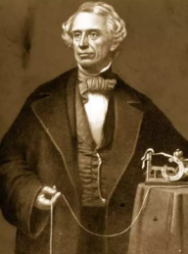
History of Morse Code
Morse Code is a system of communication that uses dots an History of Morse Coded dashes to represent letters and numbers. It was developed in the early 1830s by Samuel Morse and Alfred Vail as a way to transmit messages over long distances using electrical telegraph lines.
.The first Morse Code transmission was sent in 1844, and the system quickly became popular for long-distance communication. It was used extensively during the Civil War, and continued to be used throughout the 19th and early 20th centuries.

Slide 4
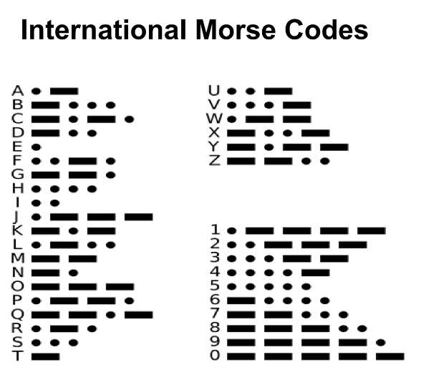
International Morse Code is a standardized system of communication using short and long signals, known as dots and dashes, to represent letters, numbers, and symbols. It was developed in the mid-19th century and is still used today in various forms for emergency communication, aviation, and amateur radio.

Slide 5
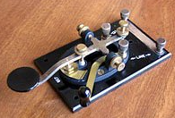
Morse code transmitter

Slide 6
Types of morse code transmitters
Telegraph Transmission
Light Signal Transmission
Radio Transmission
In telegraph transmission, an operator sends Morse Code by tapping a key, which opens and closes an electrical circuit. The resulting current is transmitted along a wire to the receiving station, where it is interpreted by another operator.
In light signal transmission, Morse Code is sent using a series of flashes of light. This can be done using a flashlight, signal lamp, or other light source. The code is received by someone who can see the flashes and interpret the code.
In radio transmission, Morse Code is sent as a series of short and long radio waves. These waves are transmitted through the air and can be received by a radio receiver, which interprets the code.

Slide 7
Morse Code Usage
Military
Morse code has been used extensively by the military for communication during times of conflict. It is still used today by some branches of the military as a backup communication method in case other systems fail.
Amateur Radio
Amateur radio operators use Morse code as a means of communication. It is often used in emergency situations when other forms of communication are not available or reliable.
Aviation
Morse code was used in aviation as a means of communication before the development of radio communication. Pilots would use a signal lamp to communicate with the ground using Morse code.
Navigation
Morse code is still used in navigation today. It is used to identify radio beacons and to transmit navigational information to ships and aircraft.

Slide 8


QUICK EXERCISE
Shourysen a.k.a clown of the class

Slide 9

HELP HIM WRITE THIS IN MORSE CODE!!!
U are pretty
.._ ._ ._. . . _ _ . ._. . _ _ _._ _

Slide 10


